Slide 1

LINUX
Presented by:
Kumar
gdfdgdfdhfhfjdfhjgfhgfgjdfhgjdhffkkfjgkfj

Slide 2
Modules
Course Content
Linux Installation & Hard Disk Partition Details
LINUX Commands & Shell Commands
User Administration
Network Configuration
Job Automation
Disk quota management
Package Management
DNS
Managing Installed Services
Managing Process
Apache Web Server
MySQL Server and MariaD
Log Server and Log File

Slide 3
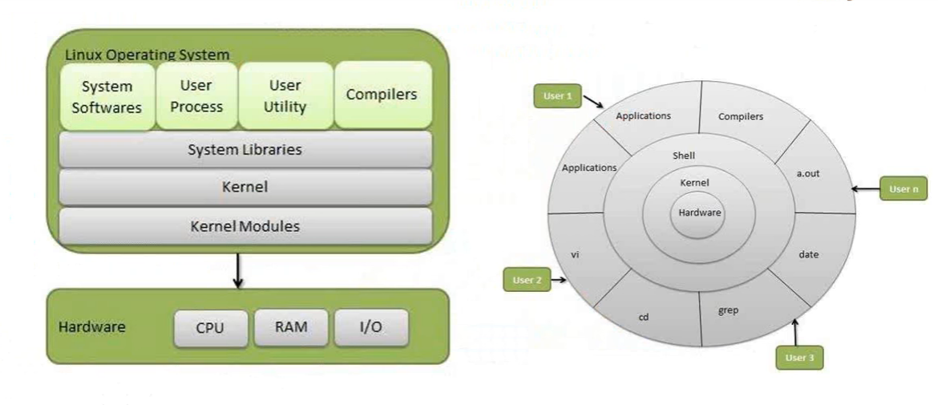

Slide 4
Linux Distributions
Arch Linux | ClearOS
CentOS | Arch Linux
Damn Small Linux | Slackware
Debian | Fedora
Red Hat Enterprise Linux | OpenSUSE
SUSE Linux Enterprise Server | Puppy Linux
Oracle Linux | Ubuntu
Mageia / Mandriva | Xandros

Slide 5
Why Use Linux?
Costs less
Stable
Reliable
Extremely powerful

Slide 6
LINUX VS WINDOWS
Financial Differences
Technical Differences
End-User Differences

